Slide 1
Reactions 9
H. Statistical Gas Model of the Nucleus

Slide 2































Slide 3




















Slide 4






















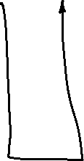














Slide 5






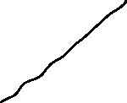

































Slide 6













Slide 7




























Slide 8








































Slide 9













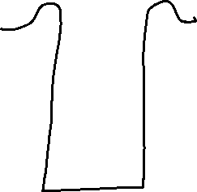



































Slide 10










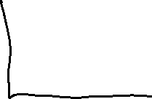









Slide 11
























Slide 12































Slide 13


































Slide 14































Slide 15









































Slide 16













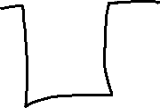































Slide 17























Slide 18




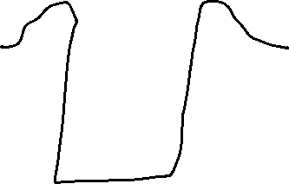
































Slide 19

































